Slide 1
Understanding and Practicing Arduino
Phenomena

Slide 2
Today’s Focus
Design Your Own Circuit
Write Your Own Program

Slide 3
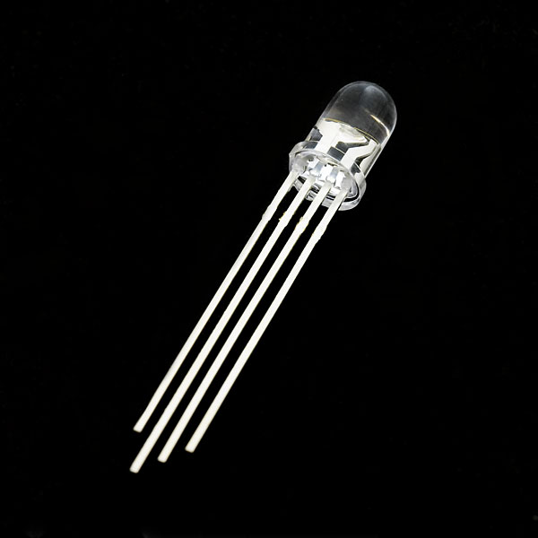
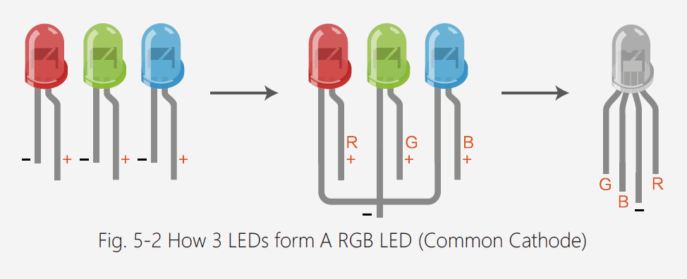
RGB LED

Slide 4
if (…){…} else {…} Statement
An if statement can be followed by an optional else statement, which executes when the Boolean expression is false.
If ( condition ) // true or false
{
// statement
}
else
{
// statement
}

Slide 5
Serial Class: Print Out Data
https://www.arduino.cc/reference/en/language/functions/communication/serial/
It is used for communication between the Arduino board and a computer or other devices.
Serial.begin(9600); // opens serial port, sets data rate to 9600 bps.
https://www.arduino.cc/en/Serial/Begin
Serial.print( variable ); // print variable.

Slide 6
Your Task
Build a circuit that connects the RGB LED to the Arduino
Write a program that blinks the RGB LED following a red, green, blue pattern. Pausing time increases by 1 second between each blink.

Slide 7
Challenge
Challenge 1
Write a function and perform the task by calling the function
Challenge 2
Write a breathing light

Slide 8
A Document for Brain Storming
The Idea Gathering Document:
https://docs.google.com/document/d/1fLm2RJOFSxDVxatytCI86R-EuLYS0xKe0N-XZOGQZIs/edit

Slide 9
Great Work
Have a Wonderful Week!

